Slide 1
Application Layer

Slide 2
Agenda
Application Layer
DNS
DHCP
Packet sniffing using Wireshark
Application programming
Tasks for Today
References
Questions

Slide 3
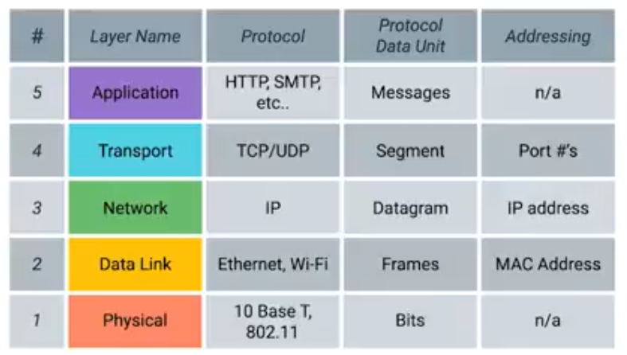
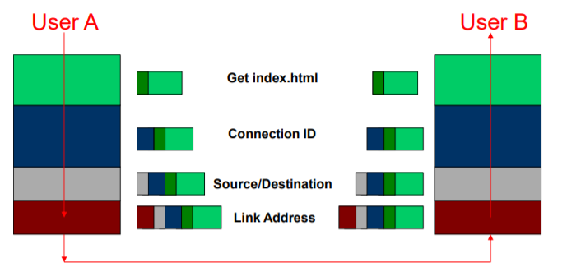
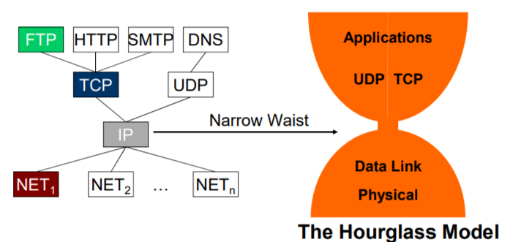
Application layer
This is what makes internet fun and useful.
Applications facilitate communication using protocols and underlying layers.
OSI Application layer is conceptually different from TCP/IP Application layer.
Examples of Application layer protocols:
  HTTP
  FTP
  DNS
  DHCP

Slide 4
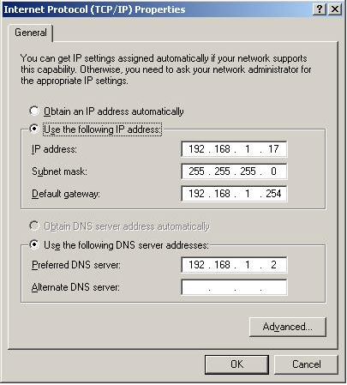
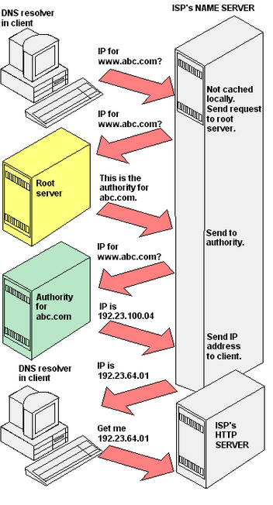
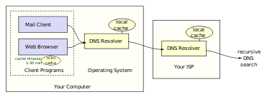
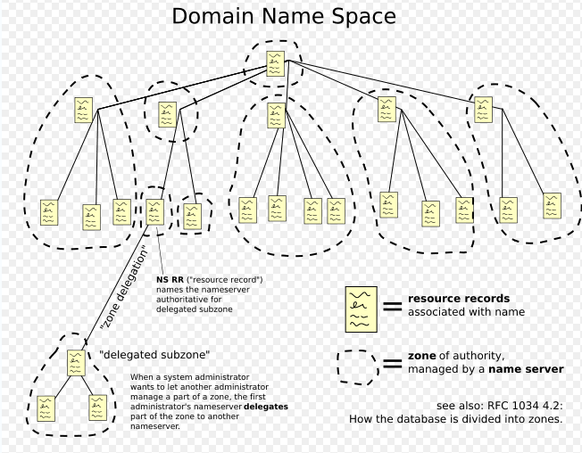
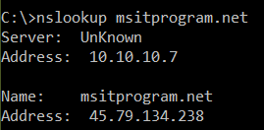
DNS
Google DNS: https://dns.google.com/

Slide 5
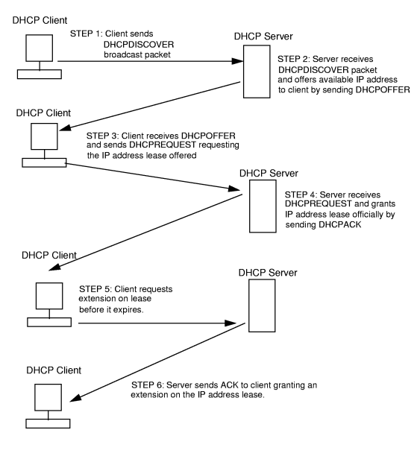
DHCP
Dynamic Host Configuration Protocol - Defined in RFC 2132
Network management tool used by networks to assign IP addresses to workstations.
  Absence of DHCP means static IP assignment.
RFC 3315 describes DHCPv6 for dynamically assigning IPv6 addresses.

Slide 6
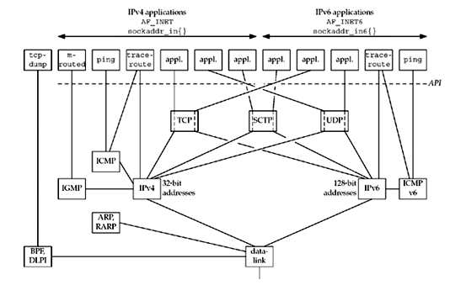
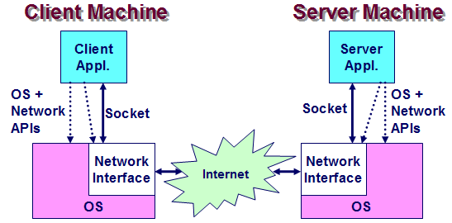
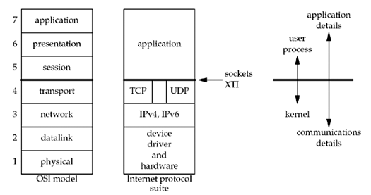
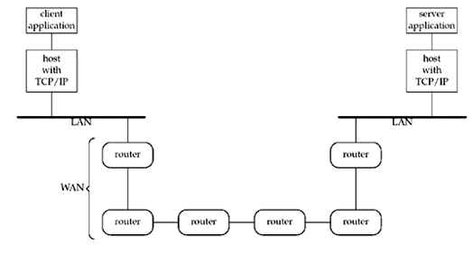
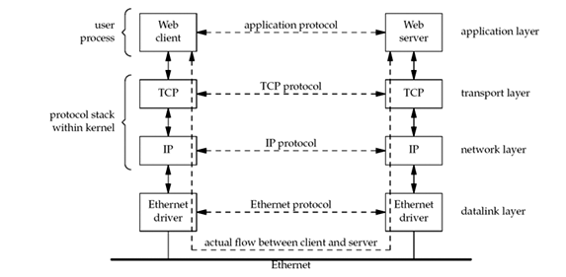
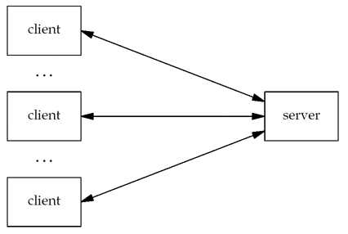

Networked Applications

Slide 7

Packet sniffer
Also called packet analyzer, ethernet sniffer.
Intercept and log traffic passing (some times decodes) over a digital network.
In this course we will use Wireshark for packet analyzing.
  Wireshark uses libpcap library also available in CLI called tshark.
  It is freely available open source software.

Slide 8

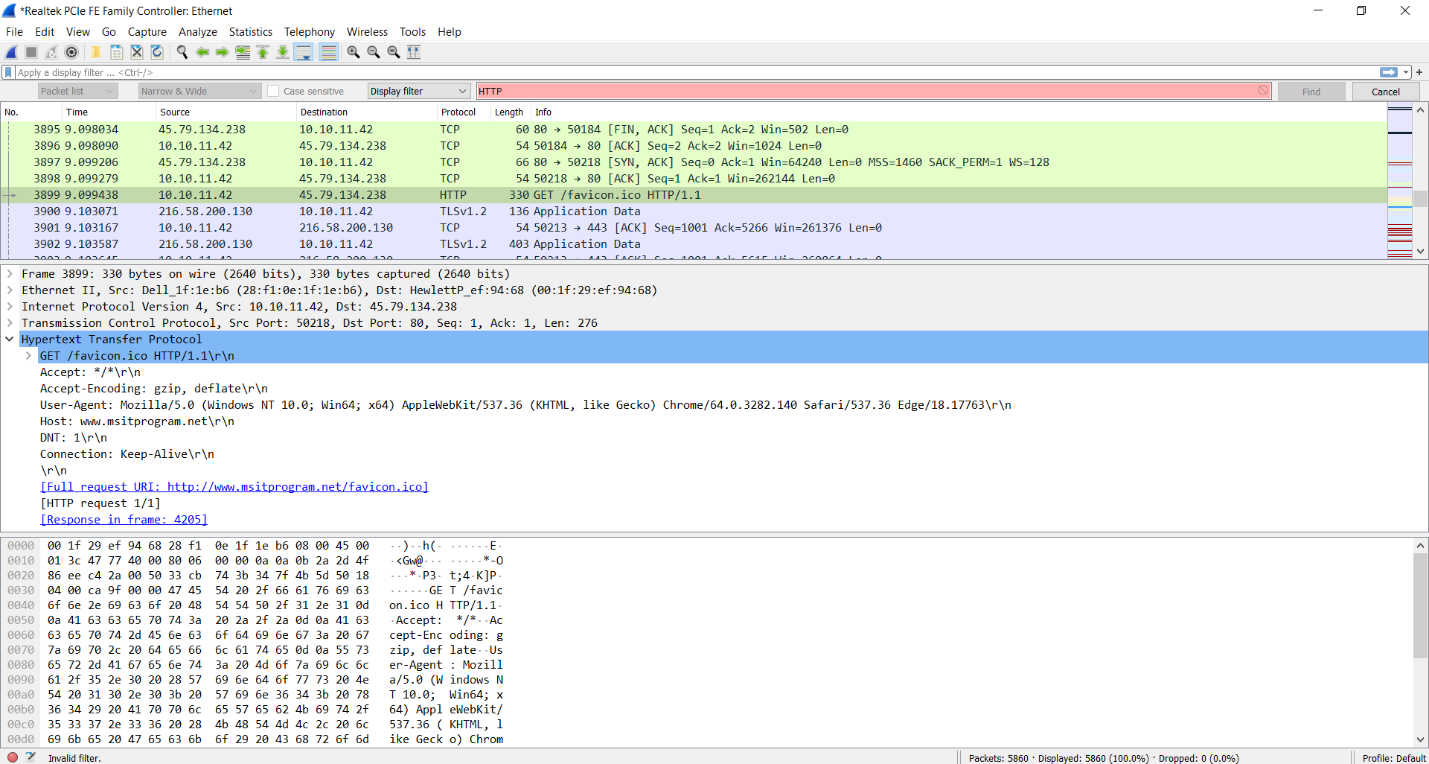
Wireshark

Slide 9
Tasks for Today
Commands for the day
  Linux: dig, wget , ifconfig
  Windows: ipconfig
  Both: nslookup
Wireshark
  Installations
  Web traffic such as google.com and websites that are http to see content as text
  HTTP request and response capturing and analyzing.
  Using filters view web page data
  Observe / analyze DNS and DHCP traffic

Slide 10
References
Google DNS: https://en.wikipedia.org/wiki/Domain_Name_System,https://www.youtube.com/watch?v=goiINQqXCbY, https://dns.google.com/ , and https://developers.google.com/speed/public-dns/docs/using
DHCP: RFC 2131,https://en.wikipedia.org/wiki/Dynamic_Host_Configuration_Protocol , https://www.youtube.com/watch?v=eMcczkNPS70 , https://wiki.wireshark.org/DHCP
Wireshark: https://www.wireshark.org/, and https://www.wireshark.org/docs/wsug_html_chunked/

Slide 11
Question and Answers (Q&A)
Thank you.

